Slide 1

The current state and future of mobile security in the light of the recent mobile security threat reports
Paper Link: https://link.springer.com/article/10.1007/s11042-023-14400-6
Course: CSE 707
Sania Azhmee Bhuiyan
ID: 23266033
Team: 16
Course instructor: Annajiat Alim Rasel

Slide 2
MOTIVATION
Smartphones have become small computers that meet many of our needs, from e-mail and banking transactions to communication and social media use.
Hacker attacks and the spread of malware have also increased. Today, current mobile malware detection and defense technologies are still inadequate.
CONTRIBUTION
The main aim and contribution of this study are to collect the current state of mobile security and highlight the future of mobile security in light of the recent mobile security threat reports.

Slide 3
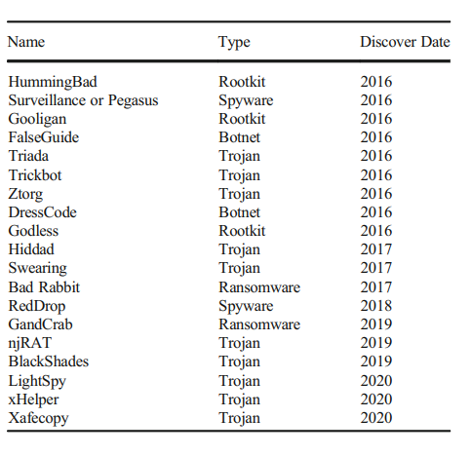

Slide 4
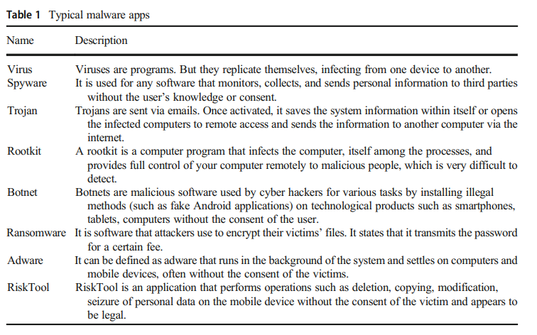

Slide 5
Types of Malicious Attacks and Mobile Vulnerabilities 1. Phishing: A method where attackers trick victims into providing sensitive information, often through deceptive emails or websites.
2. Social Engineering: Involves manipulating individuals to divulge confidential information or perform actions that may compromise security.
3. MITM (Man-In-The-Middle) Attacks: Occurs when attackers intercept and possibly alter the communication between two parties without their knowledge.

Slide 6
2. Limitations
2.1 First Limitation/Critique
The study may not fully account for the diverse and rapidly evolving nature of malware threats, which could limit the effectiveness of proposed solutions. The focus on existing types of attacks might not preemptively address emerging or unknown threats.
2.2 Second Limitation/Critique
The paper's reliance on current data and trends might not adequately predict future developments in mobile security. With the constant evolution of technology and cyber threats, the relevance of the study's findings could diminish quickly unless continuously updated.

Slide 7
Results
The paper suggests future research areas such as combining signature-based techniques with machine learning, developing new machine learning techniques for imbalanced network traffic datasets, and new classification algorithms for detecting malicious flow

Slide 8
Conclusion
Emphasizes the rapid diversification, renewal, and improvement of malware and threats.
Mobile security is interlinked with operating system security, internet communication, data encryption, and user privacy awareness

Slide 9
THANK YOU

